Slide 1

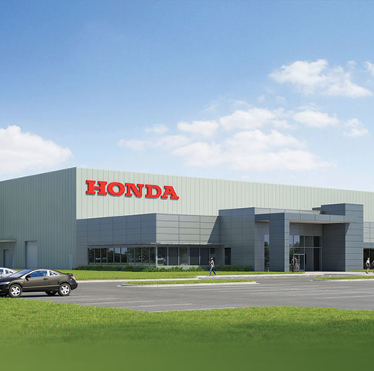

HONDA Canada
HRMN - 1016
Strategic Planning
PRESENTATION BY: MANPREET KAUR - 200554128 BAISHALI KAKATI - 200567296 GURWINDER SINGH - 200557497 SUKHMINDER KAUR - 200582090

Slide 2

Company overview
Company Overview- Honda Canada Inc. is a branch of Honda Motor Co., Ltd., which is a Japanese Multinational Corporation, established in 1969. It is known for manufacturing automobiles, motorcycles and has been building cars in Canada since 1986 in Alliston, Ontario and headquarters in Markham, Ontario
Three Strategic Initiatives-
Sustainability and Innovation
Customer Experience
Manufacturing Excellence
Financial Performance: Honda Canada performs strongly in financial terms by increasing its revenue and profits with consistency and by managing costs well and making strategic investments which helped them maintain stability in finance and in the market with success.
Corporate Social Responsibility (CSR): Blue Skies for Our Children
Challenges and Opportunities
Redefining the Honda Global Brand Slogan: How we move you, Create, Transcend, Augment.

Slide 3


Company description
The purpose of Honda Canada Inc., is to build vehicles for the people of Canada right at home and to export outside Canada. Purpose: innovations, mobility growth, sustainability and improving the life quality of consumers and the communities.
Since 1986, they produced Honda engines and its 10 millionth car in 2023 and light trucks at Alliston, Ontario, where the Honda Civic and Honda CR-V are currently manufactured.
The plant size of Honda Canada is 4 million square feet and the site size is 890 acres.
There are a total of 4200 associates working in Honda Canada.

Slide 4

Mission, vision and value
MISSION: Honda mission statement is “maintaining a global viewpoint, we are dedicated to supplying products of the highest quality, yet at a reasonable price for worldwide customer satisfaction”.
VISION: The 2030 vision statement of Honda Canada ensures that they will bring the universal passion of Honda to “serve people worldwide with the joy of expanding their life’s potential.” And toward this end, they will “lead the advancement of mobility and enable people everywhere in the world to improve their daily lives”.
CORE-VALUE: The value statement of Honda company covers up “Respect for the individual”-
Initiative
Equality
Trust
Three Joys
The Joy of Buying
The Joy of Selling
The Joy of Creating

Slide 5

Environmental Scan
Economic Environment
Changes in Currency Rates
Issue: Fluctuating costs of imported materials.
Rationale: Implement strategic financial planning to mitigate impact.
Economic Recessions
Issue: Decreased consumer spending reduces demand for automobiles.
Rationale: Plan for flexible workforce and cost-cutting measures.
Changes in Interest Rates
Issue: Affects financing costs and overall profitability.
Rationale: Monitor interest rates and adjust pricing strategies.

Slide 6

Environmental Scan
Technological Advancements
Rapid Technological Changes
Issue: Need for continuous workforce retraining.
Rationale: Invest in extensive training initiatives.
Increased Automation
Issue: Adaptation to new processes and technologies.
Rationale: Emphasize technical proficiency through targeted training.
Investment in R&D
Issue: Sustaining competitive edge in AI and EVs.
Rationale: Attract and retain top tech talent.

Slide 7

Environmental Scan
Regulatory and Legal Aspects
Environmental Regulations
Issue: Impact on products and production processes.
Rationale: Proactive training to ensure compliance.
Labor and Employment Regulations
Issue: Continuous adaptation required.
Rationale: Stay updated on legislative changes.
Tariffs and Trade Regulations
Issue: Impact on supply chain and material costs.
Rationale: Develop contingency plans and strategic sourcing.

Slide 8
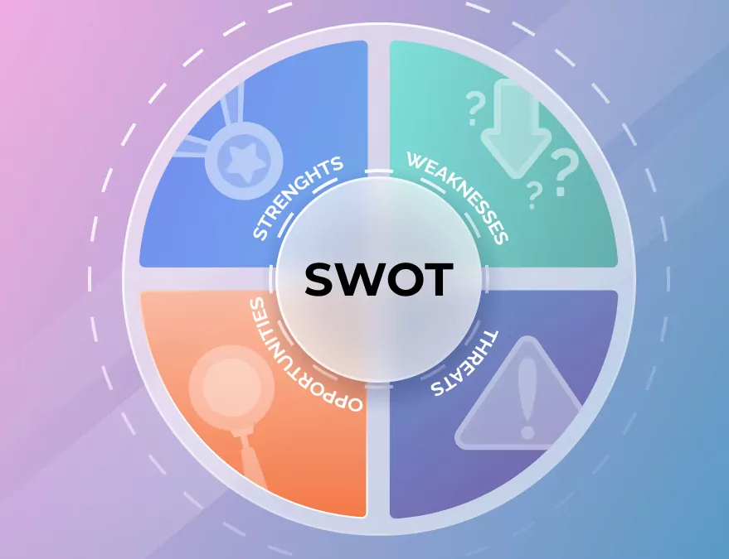
SWOT Analysis for Honda Canada
Strengths
High Brand Reputation and Customer Loyalty
Rationale: Sustains sales even in tough markets.
Developed Online Presence
Rationale: Enhances customer experience and satisfaction.
Innovation and Advanced Manufacturing
Rationale: Meets demand for electric and hybrid cars.

Slide 9

SWOT Analysis for Honda Canada
Weaknesses
High Operating Costs
Rationale: Requires cost-cutting and efficiency improvements.
Dependence on Few Models
Rationale: Diversify product line to reduce market fluctuations.
Challenges in Rapid Adaptation
Rationale: Improve organizational agility.

Slide 10

SWOT Analysis for Honda Canada
Opportunities
Growing EV Market
Rationale: Increase range of electric vehicles.
New Markets
Rationale: Expand in regions with rising vehicle numbers.
Strategic Alliances
Rationale: Collaborate with tech firms for innovation

Slide 11

SWOT Analysis for Honda Canada
Threats
Intense Competition
Rationale: Differentiate through innovation and quality.
Supply Chain Disruptions
Rationale: Diversify suppliers and strengthen supply chain strategies.
Economic Volatility
Rationale: Manage economic uncertainty through strategic cost control.

Slide 12

HR Strategy Priorities
Talent Acquisition and Development
Emphasis: Cutting-edge production and EV innovation.
Rationale: Promotes competitiveness and fills skill gaps.
Employee Engagement and Retention
Emphasis: Key engineering and technical roles.
Rationale: Reduces turnover and increases satisfaction.
Diversity and Inclusion
Goals: Diversity recruiting, unconscious bias training, support for employee resource groups.
Rationale: Enhances innovation and meets legal obligations.

Slide 13

Action plan
Talent Acquisition and Development
Targeted Recruitment Campaign
Steps: Use social media, attend job fairs, highlight innovative projects.
Internal Training in Emerging Technologies
Steps: Develop training programs, conduct seminars, assess efficacy.
Collaborative Programs with Universities
Steps: Form partnerships, create co-op programs, offer real-world experience.

Slide 14

Action plan
Employee Engagement and Retention
Revise Pay Structure
Steps: Review current structure, benchmark industry standards, adjust accordingly.
Monthly Employee Recognition Program
Steps: Establish criteria, communicate program benefits, recognize achievements.
Career Development Plans
Steps: Create plans, identify key skills, provide career advancement tools.

Slide 15

Action plan
Diversity and Inclusion
Set Measurable Diversity Objectives
Steps: Define goals, implement tracking, report progress regularly.
Mandatory Diversity Training
Steps: Develop training, mandate attendance, evaluate impact.
Mentorship Programs for Under-represented Groups
Steps: Identify mentors and mentees, pair based on career goals, monitor progress.

Slide 16
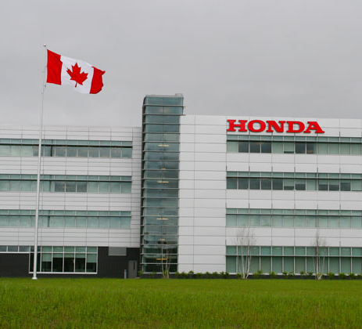
References
Company overview | Honda in Canada. (n.d.)., https://www.hondacanadamfg.ca/our-company/ https://www.hondacanadamfg.ca/our-products/
Corporate Strategy | Honda in Canada. (n.d.)., https://global.honda/en/sustainability/integratedreport/corporate-strategy/
https://www.torquenews.com/1063/honda-slogan-promises-blue-skies-our-children#
Environmental Sustainability Initiatives | Honda in Canada. (n.d.). https://www.hondacanada.ca/environment
Honda in Canada: Our mission & corporate responsibility. (n.d.). https://www.hondacanada.ca/home
Jurevicius, O. (2023, March 30). SWOT analysis of Honda 2023. Strategic Management Insight. https://strategicmanagementinsight.com/swot-analyses/honda-swot-analysis/
Mission Statement https://mission-statement.com/honda/

